Slide 1
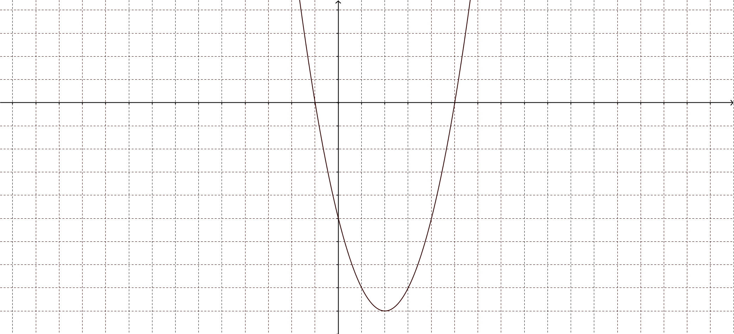
What do you know?
What might be true?
What do you want to ask?

Slide 2
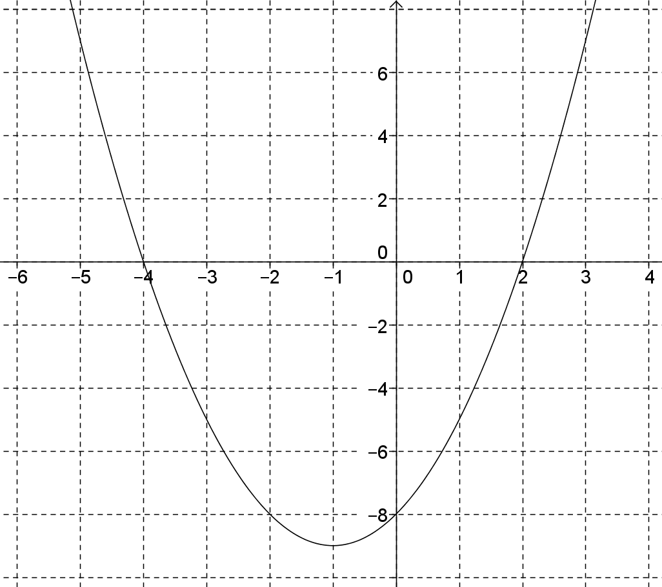
1. What is the Equation of this Curve
y=(x+4)(x-2)
y=x²+2x-8
y=(x+1)²-9

Slide 3
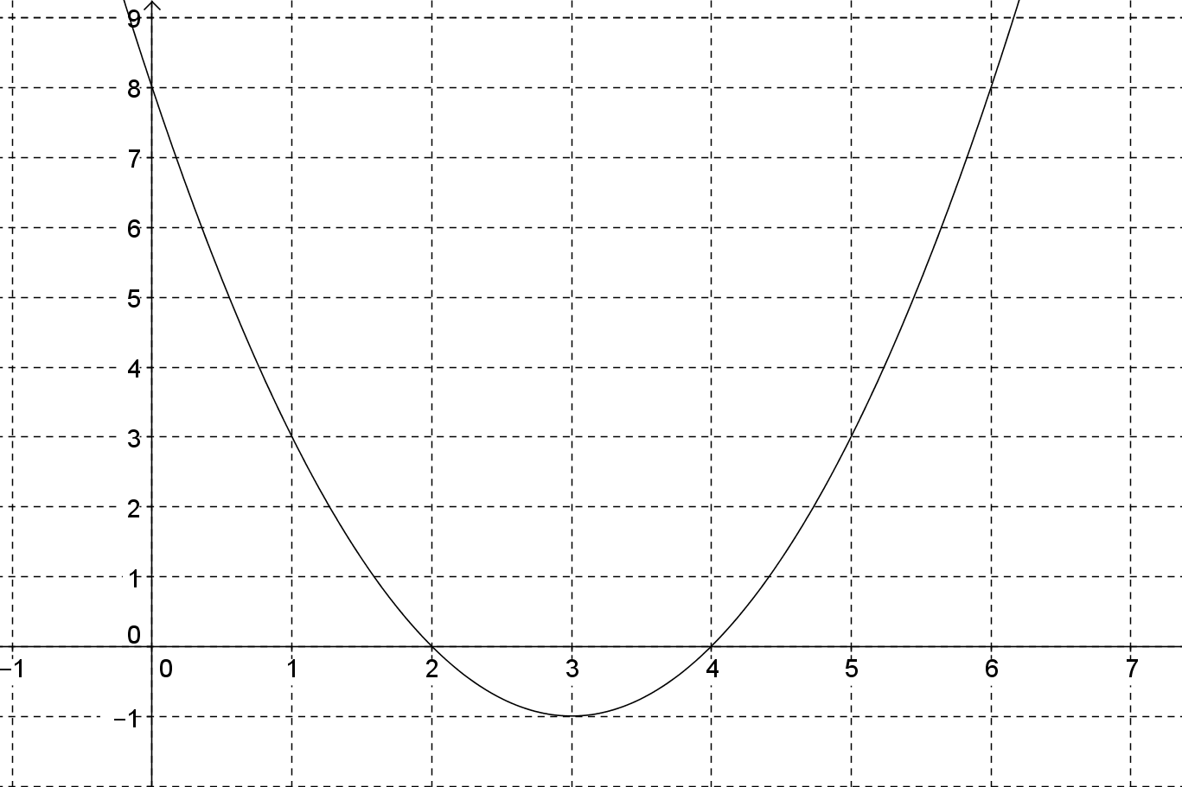
2. What is the Equation of this Curve
y=(x-4)(x-2)
y=x²-6x+8
y=(x-3)²-1

Slide 4
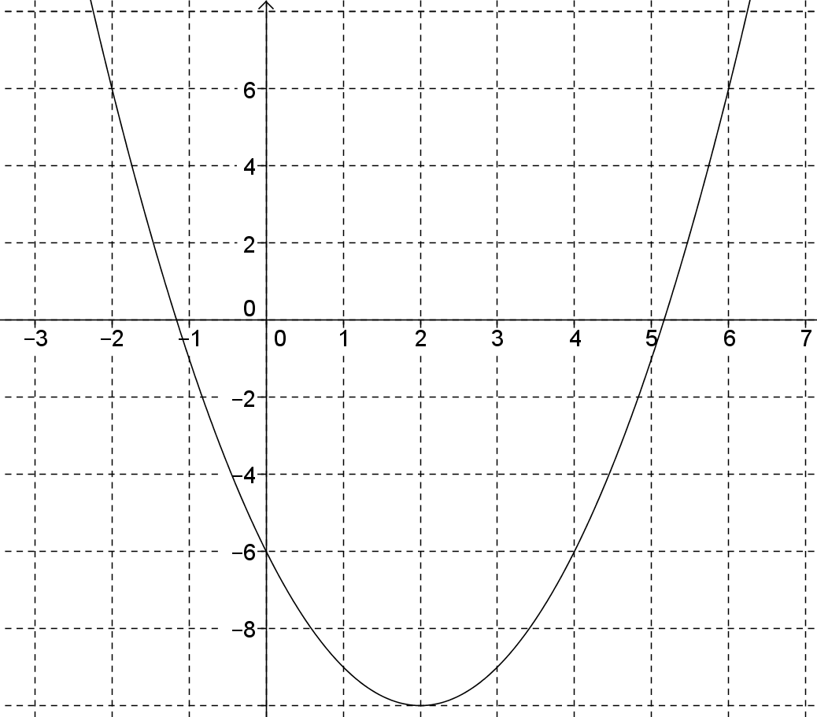
3. What is the Equation of this Curve
y=x²-4x-6
y=(x-2)²-10

Slide 5
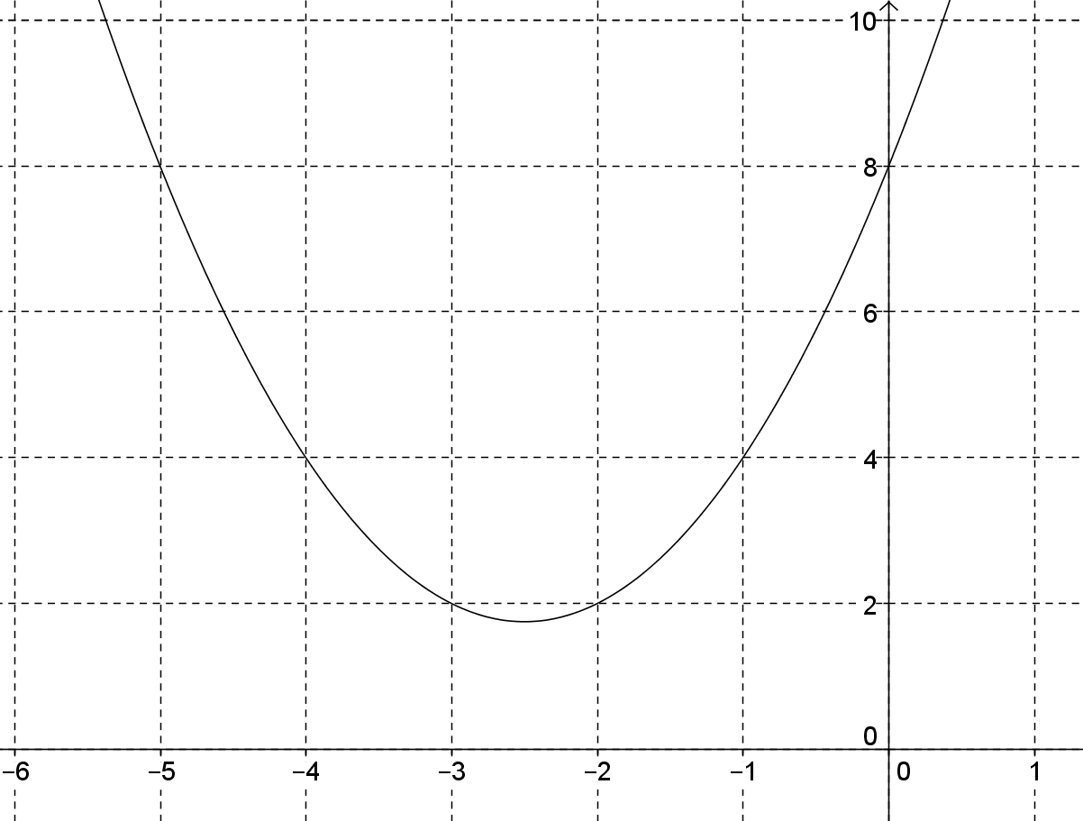
4. What is the Equation of this Curve
y=x²+5x+8
y=(x-2.5)²+1.75

